Slide 1
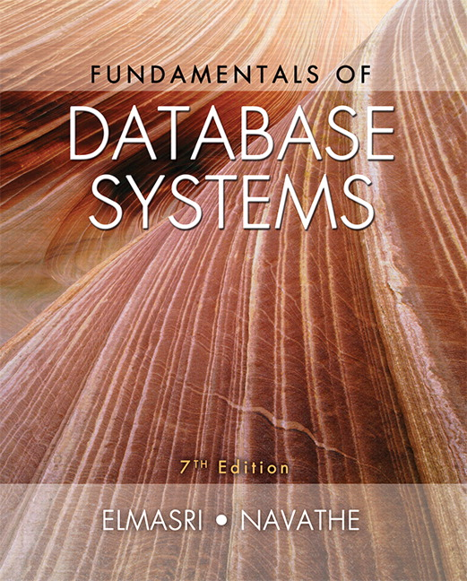

Slide 2
CHAPTER 30
Database Security

Slide 3
30.1 Introduction to Database Security Issues
Database security a broad area
  Legal, ethical, policy, and system-related issues
Threats to databases
  Loss of integrity
    Improper modification of information
  Loss of availability
    Legitimate user cannot access data objects
  Loss of confidentiality
    Unauthorized disclosure of confidential information

Slide 4
Introduction to Database Security Issues (cont’d.)
Database works as part of a network of services
  Applications, Web servers, firewalls, SSL terminators, and security monitoring systems
Types of database control measures
  Access control
  Inference control
  Flow control
  Encryption

Slide 5
Introduction to Database Security Issues (cont’d.)
Discretionary security mechanisms
  Used to grant privileges to users
Mandatory security mechanisms
  Classify data and users into various security classes
  Implement security policy
Role-based security

Slide 6
Introduction to Database Security Issues (cont’d.)
Control measures
  Access control
    Handled by creating user accounts and passwords
  Inference control
    Must ensure information about individuals cannot be accessed
  Flow control
    Prevents information from flowing to unauthorized users
  Data encryption
    Used to protect sensitive transmitted data

Slide 7
Database Security and the DBA
Database administrator (DBA)
  Central authority for administering database system
  Superuser or system account
DBA-privileged commands
  Account creation
  Privilege granting
  Privilege revocation
  Security level assignment

Slide 8
Access Control, User Accounts, and Database Audits
User must log in using assigned username and password
Login session
  Sequence of database operations by a certain user
  Recorded in system log
Database audit
  Reviewing log to examine all accesses and operations applied during a certain time period

Slide 9
Sensitive Data and Types of Disclosures
Sensitivity of data
  Inherently sensitive
  From a sensitive source
  Declared sensitive
  A sensitive attribute or sensitive record
  Sensitivity in relation to previously disclosed data

Slide 10
Sensitive Data and Types of Disclosures (cont’d.)
Factors in deciding whether it is safe to reveal the data
  Data availability
    Not available when being updated
  Access acceptability
    Authorized users
  Authenticity assurance
    External characteristics of the user
    Example: access only allowed during working hours

Slide 11
Sensitive Data and Types of Disclosures (cont’d.)
Typically a tradeoff between precision and security
Precision
  Protect all sensitive data while making available as much nonsensitive data as possible
Security
  Ensuring data kept safe from corruption and access suitably controlled

Slide 12
Relationship Between Information Security and Information Privacy
Concept of privacy goes beyond security
  Ability of individuals to control the terms under which their personal information is acquired and used
  Security a required building block for privacy
Preventing storage of personal information
Ensuring appropriate use of personal information
Trust relates to both security and privacy

Slide 13
30.2 Discretionary Access Control Based on Granting and Revoking Privileges
Two levels for assigning privileges to use a database system
  Account level
    Example: CREATE SCHEMA or CREATE TABLE privilege
    Not defined for SQL2
  Relation (or table) level
    Defined for SQL2
    Access matrix model

Slide 14
Discretionary Access Control (cont’d.)
Relation or table level (cont’d.)
  Each relation R assigned an owner account
  Owner of a relation given all privileges on that relation
  Owner can grant privileges to other users on any owned relation
    SELECT (retrieval or read) privilege on R
    Modification privilege on R
    References privilege on R

Slide 15
Specifying Privileges Through the Use of Views
Consider owner A of relation R and other party B
  A can create view V of R that includes only attributes A wants B to access
    Grant SELECT on V to B
Can define the view with a query that selects only those tuples from R that A wants B to access

Slide 16
Revocation and Propagation of Privileges
Revoking of Privileges
  Useful for granting a privilege temporarily
  REVOKE command used to cancel a privilege
Propagation of privileges using the GRANT OPTION
  If GRANT OPTION is given, B can grant privilege to other accounts
  DBMS must keep track of how privileges were granted if DBMS allows propagation

Slide 17
Revocation and Propagation of Privileges (cont’d.)
Horizontal and vertical propagation limits
  Limiting horizontal propagation to an integer number i
    Account B given the GRANT OPTION can grant the privilege to at most i other accounts
  Vertical propagation limits the depth of the granting of privileges
  Not available currently in SQL or other relational systems

Slide 18
30.3 Mandatory Access Control and Role-Based Access Control for Multilevel Security
Mandatory access control
  Additional security policy that classifies data and users based on security classes
  Typical security classes
    Top secret
    Secret
    Confidential
    Unclassified
  Bell-LaPadula model
    Subject and object classifications

Slide 19
Mandatory Access Control and Role-Based Access Control for Multilevel Security (cont’d.)
Simple security property
  Subject S not allowed read access to object O unless class(S)≥class(O)
Star property
  Subject not allowed to write an object unless class(S)≤class(O)
  Prevent information from flowing from higher to lower classifications
Attribute values and tuples considered as data objects

Slide 20
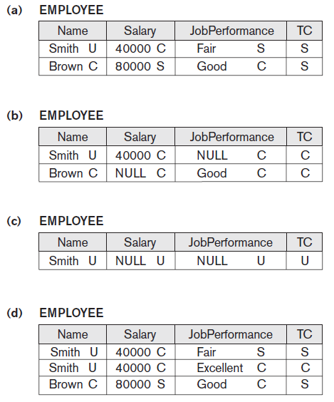
Figure 30.2 A multilevel relation to illustrate multilevel security (a) The original EMPLOYEE tuples (b) Appearance of EMPLOYEE after filtering for classification C users (c) Appearance of
EMPLOYEE after filtering
for classification U users
(d) Polyinstantiation of the
Smith tuple

Slide 21
Comparing Discretionary Access Control and Mandatory Access Control
DAC policies have a high degree of flexibility
  Do not impose control on how information is propagated
Mandatory policies ensure high degree of protection
  Rigid
  Prevent illegal information flow

Slide 22
Role-Based Access Control
Permissions associated with organizational roles
  Users are assigned to appropriate roles
Can be used with traditional discretionary and mandatory access control
Mutual exclusion of roles
  Authorization time exclusion
  Runtime exclusion
Identity management

Slide 23
Label-Based Security and Row-Level Access Control
Sophisticated access control rules implemented by considering the data row by row
Each row given a label
  Used to prevent unauthorized users from viewing or altering certain data
Provides finer granularity of data security
Label security policy
  Defined by an administrator

Slide 24
XML Access Control
Digital signatures for XML
  XML Signature Syntax and Processing specification
    Defines mechanisms for countersigning and transformations
XML encryption
  XML Encryption Syntax and Processing specification
    Defines XML vocabulary and processing rules

Slide 25
Access Control Policies for the Web and Mobile Applications
E-commerce environments require elaborate access control policies
  Go beyond traditional DBMSs
Legal and financial consequences for unauthorized data breach
Content-based access control
  Takes protection object content into account
Credentials

Slide 26
30.4 SQL Injection
SQL injection
  Most common threat to database system
Other common threats
  Unauthorized privilege escalation
  Privilege abuse
  Denial of service
  Weak authentication

Slide 27
SQL Injection Methods
Attacker injects a string input through the application
  Changes or manipulates SQL statement to attacker’s advantage
Unauthorized data manipulation or execution of system-level commands
SQL manipulation
  Changes an SQL command in the application
  Example: adding conditions to the WHERE clause

Slide 28
SQL Injection Methods (cont’d.)
SQL manipulation (cont’d.)
  Typical manipulation attack occurs during database login
Code injection
  Add additional SQL statements or commands that are then processed
Function call injection
  Database or operating system function call inserted into vulnerable SQL statement to manipulate data or make a privileged system call

Slide 29
Risks Associated with SQL Injection
Database fingerprinting
Denial of service
Bypassing authentication
Identifying injectable parameters
Executing remote commands
Performing privilege escalation

Slide 30
Protection Techniques
Blind variables (using parameterized statements)
  Protects against injection attacks
  Improves performance
Filtering input (input validation)
  Remove escape characters from input strings
  Escape characters can be used to inject manipulation attacks
Function security
  Standard and custom functions should be restricted

Slide 31

30.5 Introduction to Statistical
Database Security
Statistical databases used to provide statistics about various populations
  Users permitted to retrieve statistical information
  Must prohibit retrieval of individual data
Population: set of tuples of a relation (table) that satisfy some selection condition
Figure 30.3 The PERSON relation schema for illustrating statistical database security

Slide 32
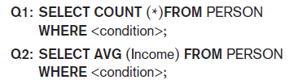
Introduction to Statistical
Database Security (cont’d.)
Only statistical queries are allowed
Preventing the inference of individual information
  Provide minimum threshold on number of tuples
  Prohibit sequences of queries that refer to the same population of tuples
  Introduce slight noise or inaccuracy
  Partition the database
    Store records in groups of minimum size

Slide 33
30.6 Introduction to Flow Control
Flow control
  Regulates the distribution or flow of information among accessible objects
  Verifies information contained in some objects does not flow explicitly or implicitly into less protected objects
Flow policy
  Specifies channels along which information is allowed to move
    Simple form: confidential and nonconfidential

Slide 34
Introduction to Flow Control (cont’d.)
Covert channels
  Allows information to pass from a higher classification level to a lower classification level through improper means
  Timing channel requires temporal synchronization
  Storage channel does not require temporal synchronization

Slide 35
30.7 Encryption and Public Key Infrastructures
Encryption converts data into cyphertext
  Performed by applying an encryption algorithm to data using a prespecified encryption key
  Resulting data must be decrypted using a decryption key to recover original data
Data Encryption Standard (DES)
  Developed by the U.S. Government for use by the general public
Advanced Encryption Standard (AES)
  More difficult to crack

Slide 36
Encryption and Public Key Infrastructures (cont’d.)
Symmetric key algorithms
  Also called secret key algorithms
  Need for sharing the secret key
    Can apply some function to a user-supplied password string at both sender and receiver
Public (asymmetric) key encryption
  Involves public key and private key
  Private key is not transmitted
  Two keys related mathematically
    Very difficult to derive private key from public key

Slide 37
Encryption and Public Key Infrastructures (cont’d.)
Public (asymmetric) key encryption steps
  Each user generates a pair of keys to be used for encryption and decryption of messages
  Each user places public key in a public register or other accessible file
    Keeps companion key private
  Sender encrypts message using receiver’s public key
  Receiver decrypts message using receiver’s private key
RSA public key encryption algorithm

Slide 38
Digital Signatures
Consist of string of symbols
Each is unique
  Function of the message it is signing, along with a timestamp
  Depends on secret number unique to the signer
Public key techniques used to create digital signatures

Slide 39
Digital Certificates
Combines value of a public key with the identity of the person or service that holds the corresponding private key into a digitally signed statement
Information included in the certificate
  Owner information
  Public key of the owner
  Date of certificate issue and validity period
  Issuer identification
  Digital signature

Slide 40
30.8 Privacy Issues and Preservation
Growing challenge for database security
Limit performing large-scale mining and analysis
Central warehouses for vital information
  Violating security could expose all data
Distributed data mining algorithms
Remove identity information in released data
Inject noise into the data
  Must be able to estimate errors introduced
Mobile device privacy

Slide 41
30.9 Challenges to Maintaining
Database Security
Data quality
  Quality stamps
  Application-level recovery techniques to automatically repair incorrect data
Intellectual property rights
  Digital watermarking techniques

Slide 42
Challenges to Maintaining
Database Security (cont’d.)
Database survivability
  Confinement
  Damage assessment
  Reconfiguration
  Repair
  Fault treatment

Slide 43
30.10 Oracle Label-Based Security
Oracle label security
  Enables row-level access control
  Every table or view has an associated security policy
Virtual private database (VPD) technology
  Feature that adds predicates to user statements to limit their access in a transparent manner to the user and the application
  Based on policies

Slide 44
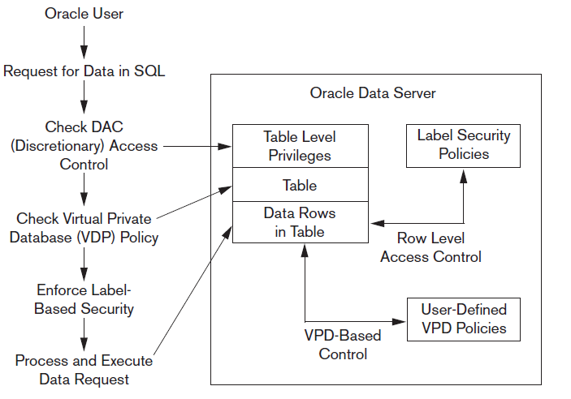
Label Security Architecture
Figure 30.4 Oracle label security architecture. Data from: Oracle (2007)

Slide 45
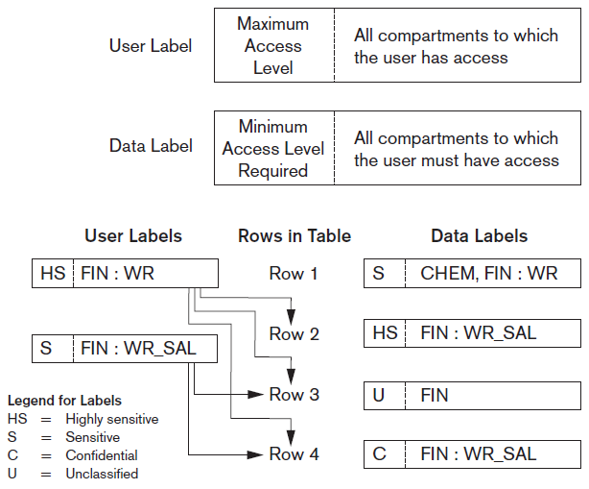
How Data Labels and User Labels Work Together
Figure 30.5 Data labels and user labels in Oracle. Data from: Oracle (2007)

Slide 46
30.11 Summary
Threats to databases
Types of control measures
  Access control
  Inference control
  Flow control
  Encryption
Mandatory access control
SQL injection
Key-based infrastructures

