Slide 1
The Arduino life
Workshop on Arduino Embedded Development Board

Slide 2
The heart of engineering isn’t calculation; It’s problem solving.
Schools may teach the numbers first, but calculation is neither the front end of engineering note its end goal. Calculation is one means among many to finding a solution that provides useful, objectively measurable improvement.

Slide 3
Introduction
Embedded Systems
Arduino Basics
Arduino Architecture
Arduino board layout. What are the resources available
Arduino IDE
Programming fundamentals
Learn by Doing – Sense, Control & Actuate
Project 1: LED Blinking
Project 2: RGB LED Interfacing & PWM Control
Project 3: Interfacing Sensors (Light, Temperature, etc.,)
Project 4: Interfacing Actuators (Motor Speed Control using PWM)

Slide 4
Industry / Robot / System
Industry / System

Slide 5
System & Control
System / Plant: “A system may be a piece of equipment, perhaps just a set of machine parts functioning together, the purpose of which is to perform a particular operation”.
Control System: “A control system is an interconnection of components forming a system configuration that provide a desired system performance”

Slide 6
Systems
Open loop systems
Closed loop systems

Slide 7
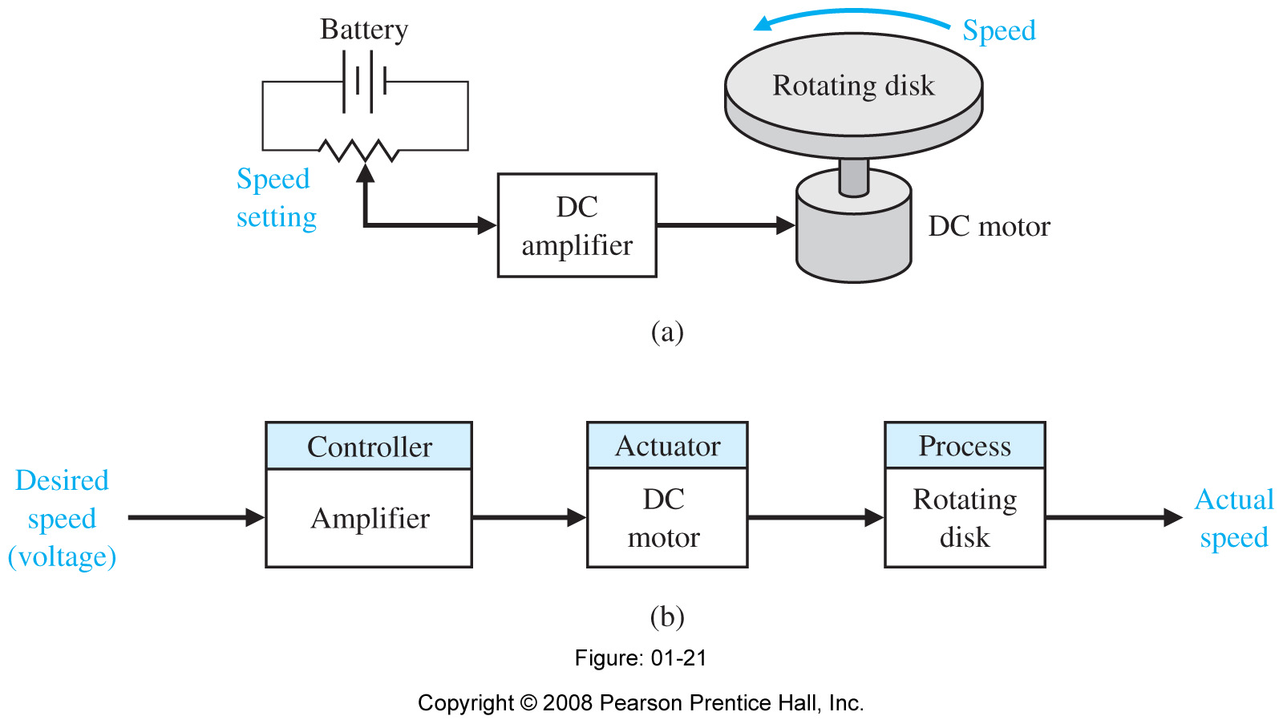
Open loop system

Slide 8
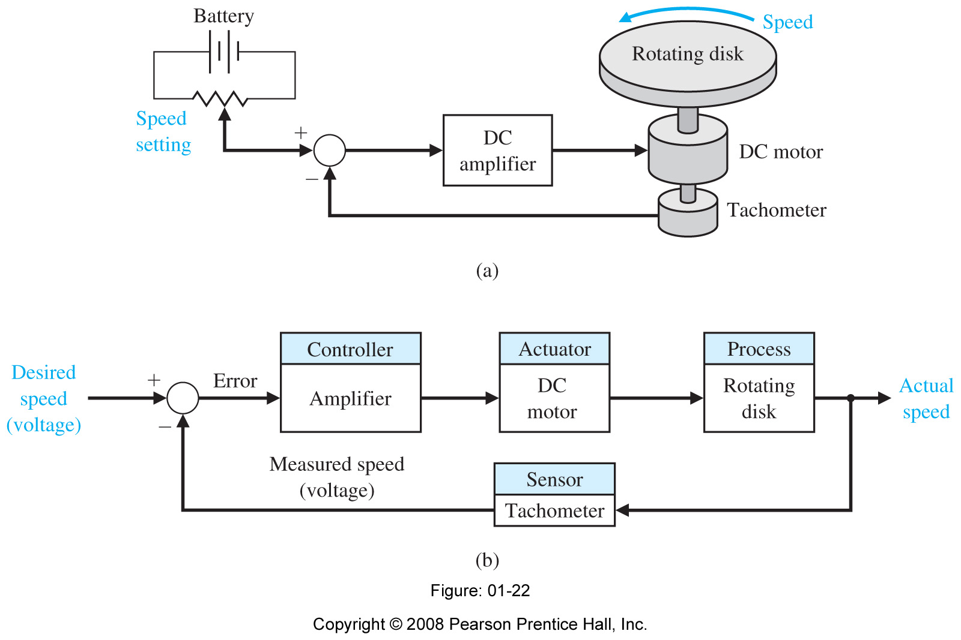
Closed loop system

Slide 9
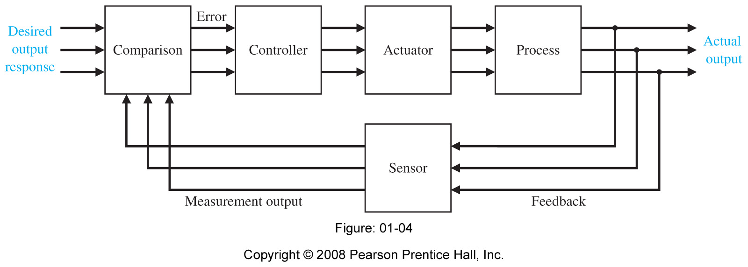
Multivariable control system

Slide 10
Embedded Systems
"It is a combination of hardware and software to perform a specific task"
“An embedded system is a computer system with a dedicated function within a larger mechanical or electrical system, often with real-time computing constraints. It is embedded as part of a complete device often including hardware and mechanical parts. Embedded systems control many devices in common use today.”

Slide 11
Components of Embedded Systems
Power Supply
Processor
Memory
Timers & Counters
Communication Ports
Input & Output
Application Specific Circuits
Software Components
Power Supply
Processor
Display Device
Buzzer for Alert
Device Drivers
MEMS devices
UART
CAN
SPI
I2C
USB
Ethernet
RS-232
RS-423
RS-485
UART
I2C
SPI
Read-Only memory(RAM)
Random Access Memory(ROM)
Electrically Erasable Programmable Read-Only Memory (EEPROM)
Speed
Unit Price
Packaging
Performance
Peripheral Set
Timer on the Chip
Operating Voltage
Number of I/O Pins
Power Consumption
Amount of RAM and ROM
Specialized Processing Units
Architecture 8-bit, 16-bit, or 32-bit
Stable & Smooth Output
Proper Output Current to Drive the Load
Perfect Power Efficiency
Stable in Different Temperature Range
Proper Noise Filtering
Proper Decoupling
Line Regulation changes
Load Regulation – Fluctuation in output voltage when load current changes
Efficiency
Input/Output Ripple Voltage
Transient Response
Allowable Dissipation
Assembler
Emulator
Debugger
Compiler

Slide 12
a few points to remember…
ANALOG
DIGITAL

Slide 13
Communication
PARALLEL
SERIAL
Sender
Receiver
1011000

Slide 14
Pulse Width Modulation

Slide 15
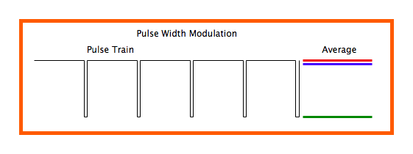
Pulse Width Modulation

Slide 16
Why Arduino..?

Slide 17
Lets Start Arduino…!

Slide 18
Arduino Basics
arduino ( arrr-dween-oh )
(n.) It's an open-source physical computing platform based on a simple microcontroller board, and a development environment for writing software for the board.

Slide 19
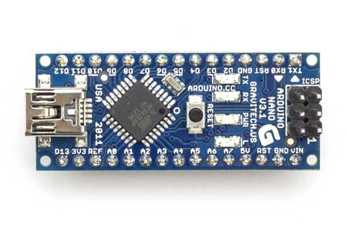
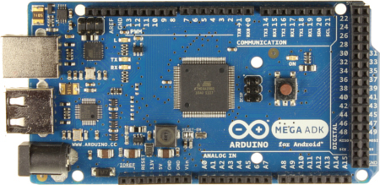
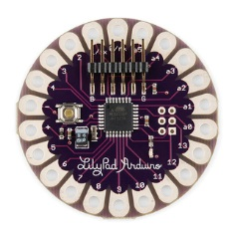
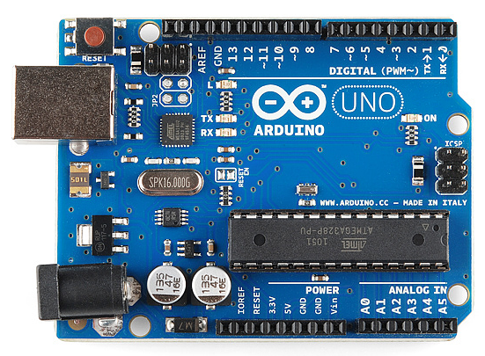
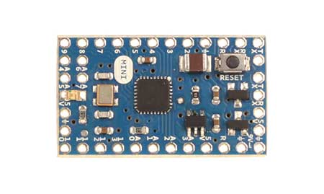
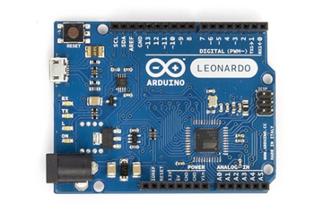
Types of Arduino Boards
Arduino Nano
Arduino Mega
Arduino LilyPad
Arduino Uno
Arduino Mini
Arduino Leonardo

Slide 20
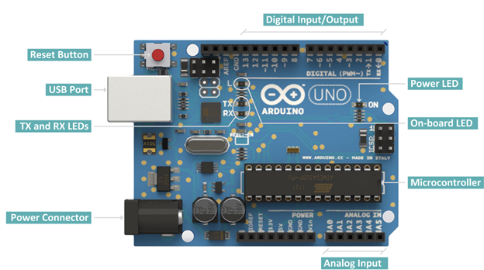
Arduino Uno
Digital pins:
14 digital IO pins
6 are PWM pins (3, 5, 6, 9, 10, and 11).
Analog pins:
6 analog pins(A0, A1, A2, A3, A4, and A5)
Takes analog values as an input

Slide 22
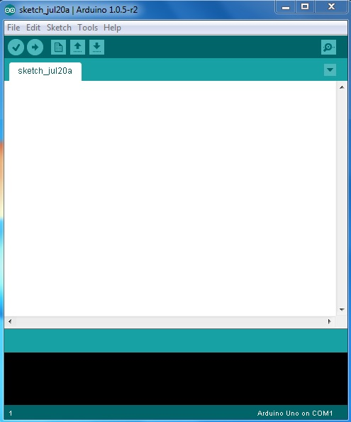
Arduino IDE
VERIFY
SERIAL MONITOR
UPLOAD
NEW TAB
OPEN
CODE GOES HERE
SAVE
BOARD & SERIAL PORT SELECTIONS

Slide 23
Basic Coding structure

Slide 24
Basic Coding structure
setup() function
Called when a sketch starts.
To initialize variables, pin modes, start using libraries, etc.
Will only run once, after each power-up or reset of the Arduino board.
loop() function
Loops consecutively.
Code in the loop() section of the sketch is used to actively control the Arduino board.
Commenting
Any line that starts with two slashes (//) will not be read by the compiler, so you can write anything you want after it.

Slide 25
pinMode()
Instruction used to set the mode (INPUT or OUTPUT) in which we are going to use a pin.
Eg: pinMode (13, OUTPUT);
ie. setting pin13 as output.
digitalWrite()
Write a HIGH or a LOW value to a digital pin.
Eg: digitalWrite (11, HIGH);
ie. setting pin 11 to high.

Slide 26
digitalRead()
Reads the value from a specified digital pin, either HIGH or LOW
Eg: int inPin=7;
val = digitalRead(inPin);
ie. reads the value from inPin and assigns it to val.
delay()
Pauses the program for the amount of time (in milliseconds) specified as parameter.
Eg: delay(1000);
ie. waits for a second (1000 ms = 1 s)

Slide 27
Component List
Arduino Uno
USB cable
LED, RGB LED
LDR
POT(10k)
Resistors
Temp sensor LM-35
Motor Driver L293D, DC Motor
Connecting wire

Slide 28
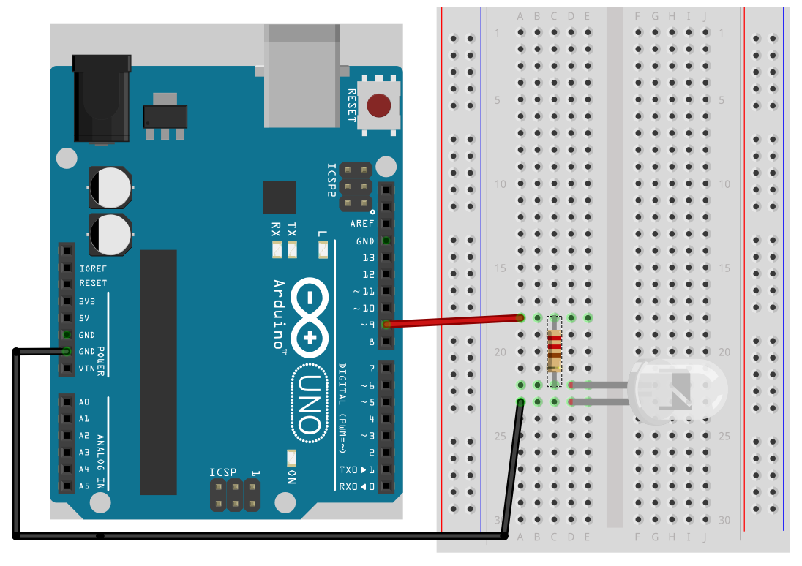
LED Blink

Slide 29
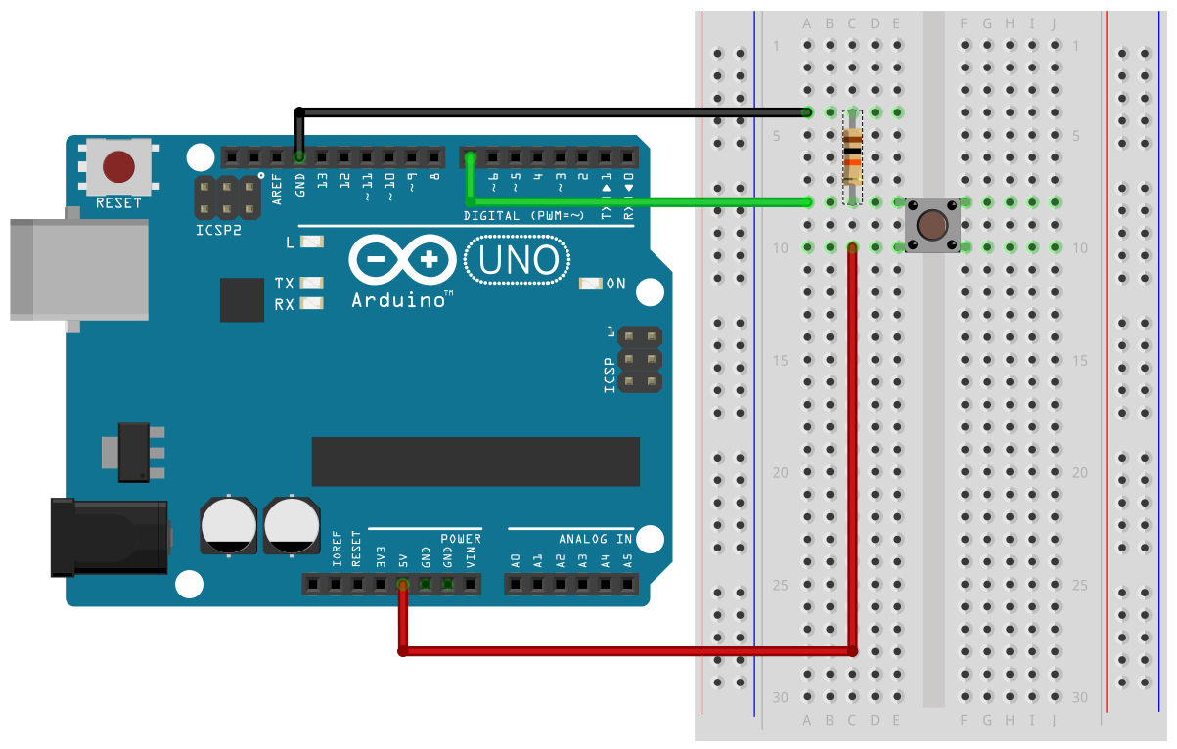
Digital Read

Slide 30
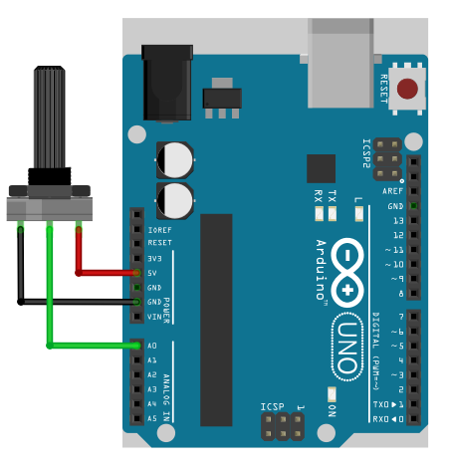
Analog Read

Slide 31
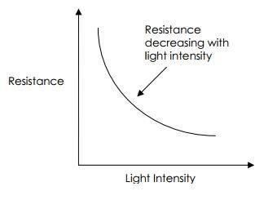
LDR (Light Dependent Resistor)

Slide 32
LDR - Wiring

Slide 33
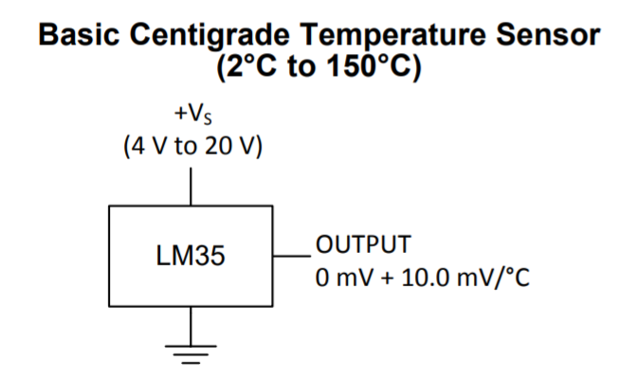
TEMP Sensor-LM35

Slide 35
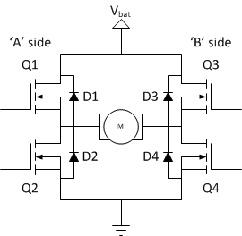
Motor Driver Circuit (L293D)
DC Motor Drive – L293D
The L293 and L293D devices are quadruple high
current half-H drivers.
Output Current of 600 mA per channel for L293D)

Slide 36
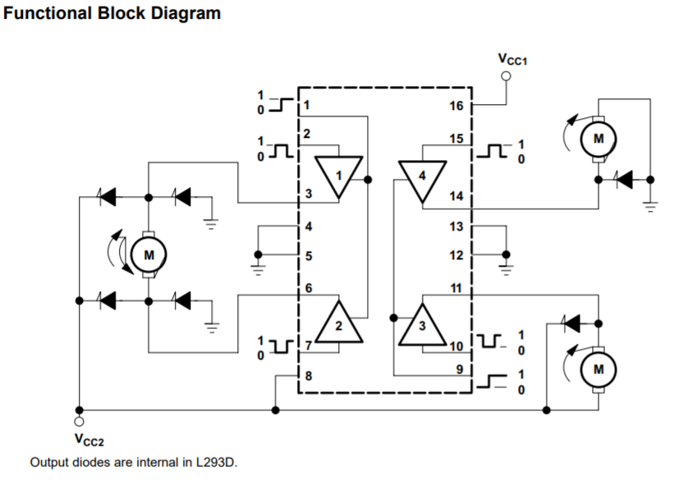
L293D Functional Block Diagram

Slide 38
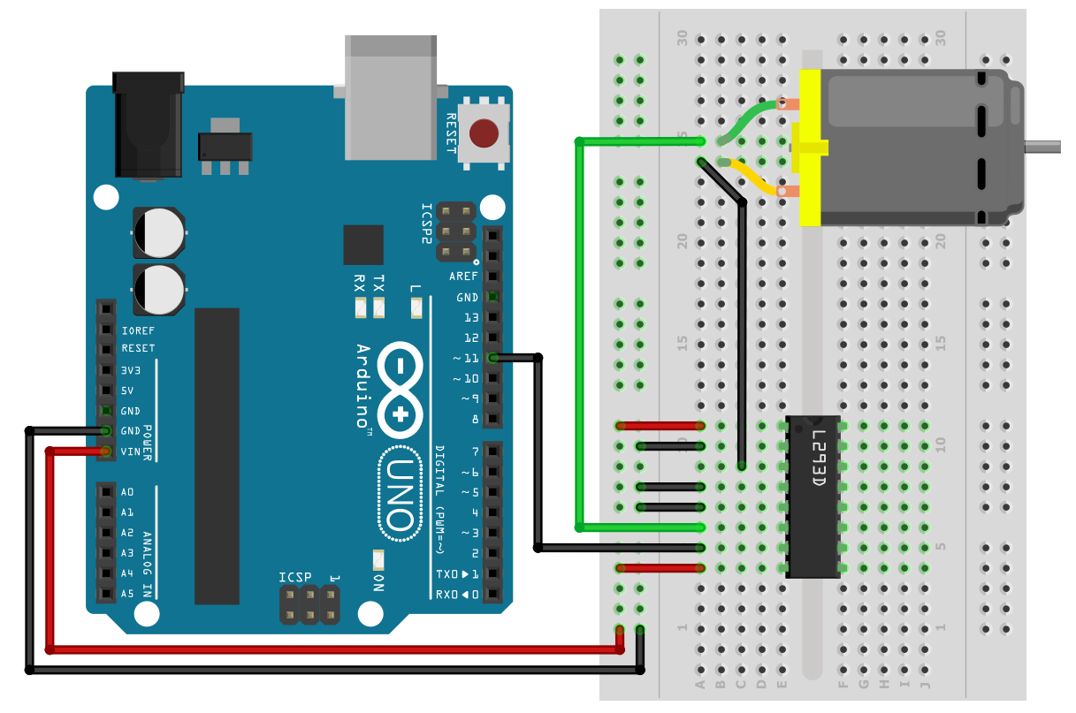
DC Motor Control using L293D

Slide 39
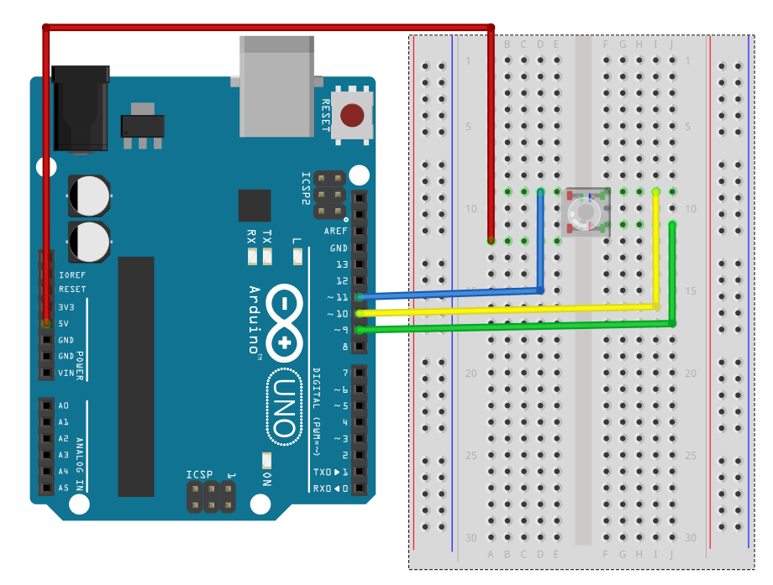
RGB LED
Vcc
Green
Red
Blue

Slide 40
“How much more Arduino can do is only left to your imagination”

Slide 41
Thank you

