Slide 1
Module 4

Slide 2
Module 4
Decision Trees- Entropy, Information Gain,
Tree construction, ID3,
Issues in Decision Tree learning
Avoiding Over-fitting, Reduced Error Pruning
The problem of Missing Attributes, Gain Ratio
Classification by Regression (CART),
Neural Networks- The Perceptron,
Activation Functions,
Training Feed Forward Network by Back Propagation.

Slide 3
Human brain
Student learns from a teacher
  Teacher asks questions and tell answers
  Teacher put questions and hint answers
  Student learn the topic and store in memory
  Based on the knowledge he solves new problems
ANN used to solve problems

Slide 4
Neural networks
An Artiﬁcial Neural Network (ANN) models the relationship between a set of input signals and an output signal using a model derived from our understanding of how a biological brain responds to stimuli from sensory inputs.
Just as a brain uses a network of interconnected cells called neurons to create a massive parallel processor, ANN uses a network of artiﬁcial neurons or nodes to solve learning problems.

Slide 5
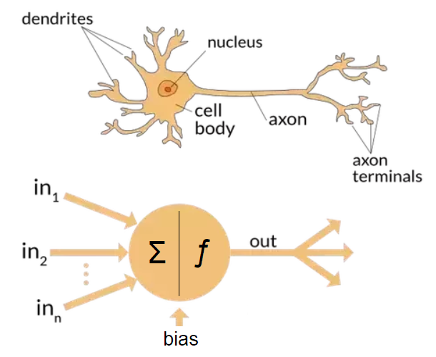

Slide 6
Artificial Neural Network
Biological Neuron
  Cell
  Dendrites
  Soma (cell body)
  Axon
Artificial Neuron
  Neuron
  Weight
  Next Input
  Output

Slide 7
Biological Motivation
In the cell, the incoming signals are received by the cell’s dendrites through a biochemical process.
The process allows the impulse to be weighted according to its relative importance or frequency.
As the cell body begins accumulating the incoming signals, a threshold is reached at which the cell ﬁres and the output signal is transmitted via an electrochemical process down the axon.
At the axon’s terminals, the electric signal is again processed as a chemical signal to be passed to the neighboring neurons across a tiny gap known as a synapse.

Slide 8
Biological Motivation
Biological learning systems are built of very complex webs of interconnected neurons.
The human brain has an interconnected network of approximately 10¹¹ neurons, each connected, on an average, to 10⁴ other neurons.
Even though the neuron switching speeds are much slower than computer switching speeds, we are able to take complex decisions relatively quickly.
Because of this, it is believed that the information processing capabilities of biological neural systems is a consequence of the ability of such systems to carry out a huge number of parallel processes distributed over many neurons.
The developments in ANN systems are motivated by the desire to implement this kind of highly parallel computation using distributed representations

Slide 9
Artiﬁcial neurons
An artiﬁcial neuron is a mathematical function conceived as a model of biological neurons.
Artiﬁcial neurons are elementary units in an artiﬁcial neural network.
The artiﬁcial neuron receives one or more inputs and sums them to produce an output.
Each input is separately weighted, and the sum is passed through a function known as an activation function or transfer function.

Slide 10
Schematic representation
The notations in the diagram have the following meanings:
x₁;x₂;:::x_{n} ∶ input signals
w₁;w₂;:::w _{n} ∶ weights associated with input signals
x₀ ∶ input signal taking the constant value 1
w₀ ∶ weight associated with x₀ (called bias)
∑∶ indicates summation of input signals
f ∶ function which produces the output
y ∶ output signal

Slide 11
Schematic representation
The function f can be expressed in the following form:
y = f (_{i=0} ∑ ^{n} w_{i} x_{i})
The small circles in the schematic representation of the artiﬁcial neuron called the nodes of the neuron.
The circles on the left side which receives the values of x₀;x₁;:::;x _{n} are called the input nodes and the circle on the right side which outputs the value of y is called output node.

Slide 12
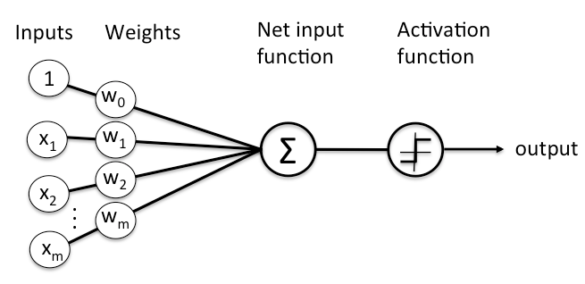

Slide 13
Activation function
In an artiﬁcial neural network, the function which takes the incoming signals as input and produces the output signal is known as the activation function.
Threshold activation function
f(x)= 1 if x > 0
−1 if x ≤ 0

Slide 14
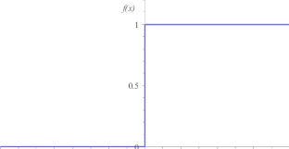
Unit step functions
The threshold activation function is also deﬁned as a unit step function in which case it is called a unit-step activation function.
f(x)= 1 if x ≥ 0
0 if x < 0

Slide 15
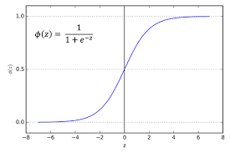
Sigmoid activation function
(logistic function)

Slide 16
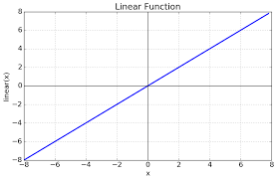
Linear activation function
F(x)= mx+c

Slide 17
Piecewise (or, saturated) linear activation function
f(x)= 0 if x < xmin
mx+c if xmin ≤ x ≤ xmax 0 if x > xmax

Slide 18
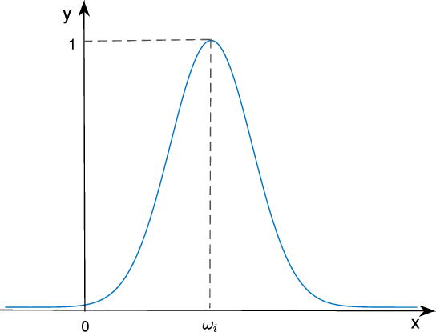
Gaussian activation function

Slide 19
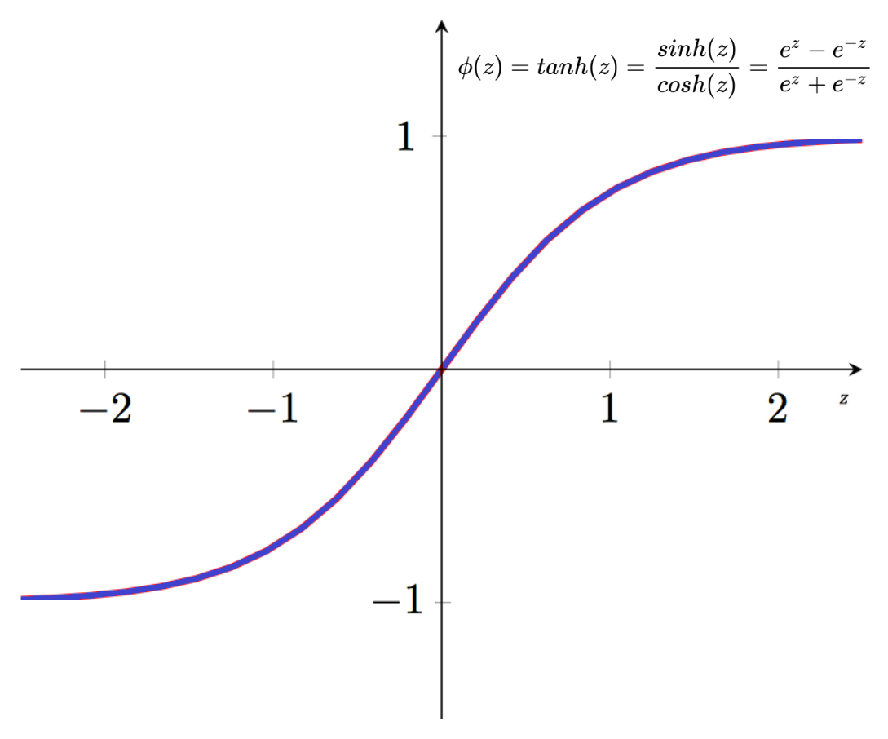
Hyperbolic tangential activation function

Slide 20
Perceptron
A perceptron is an artiﬁcial neuron in which the activation function is the threshold function.
Consider an artiﬁcial neuron having x₁, x₂, ⋯, x_{n} as the input signals and w₁, w₂, ⋯, w_{n} as the associated weights.
Let w₀ be some constant.
The neuron is called a perceptron if the output of the neuron is given by the following function:
o(x₁;x₂;:::;x_{n}) = 1 if w₀ +w₁x₁ +⋯+w_{n}x_{n} > 0
−1 if w₀ +w₁x₁ +⋯+w_{n}x_{n} ≤ 0

Slide 21
Representations of boolean functions by perceptrons
To be consistent with the conventions in the deﬁnition of a perceptron we assume that the values −1 and 1 represent the boolean constants “false” and “true” respectively.

Slide 22
Representation of x1 ANDx2
Let x1 and x2 be two boolean variables.
x1 x2 y
1 1 1
1 -1 -1
-1 1 -1
-1 -1 -1

Slide 23
Representations of OR, NAND and NOR
The functions x1 ORx2, x1 NANDx2 and x1 NORx2 can also be represented by perceptrons

Slide 24
Perceprtons
Not all boolean functions can be represented by perceptrons.
For example, the boolean function x₁ XOR x₂ cannot be represented by a perceptron.
This means that we cannot assign values to w₀;w₁;w₂ such that the expression w₀ +w₁x x₁ +w₂x₂ takes the values of x₁ XOR x₂ , and that this is the case can be easily veriﬁed also.

Slide 25
Learning a perceptron
By “learning a perceptron” we mean the process of assigning values to the weights and the threshold such that the perceptron produces correct output for each of the given training examples.

Slide 26
Perceptron learning algorithm
Deﬁnitions
In the algorithm, we use the following notations:
n : Number of input variables
y = f(z) : Output from the perceptron for an input vector z
D ={(x1;d1);:::;(xs;ds)} : Training set of s samples
xj =(xj0;xj1;:::;xjn) : The n-dimensional input vector
dj : Desired output value of the perceptron for the input xj
xji : Value of the i-th feature of the j-th training input vector
xj0 : 1
wi : Weight of the i-th input variable
wi(t) : Weight i at the t-th iteration

Slide 27
Algorithm
Step 1. Initialize the weights and the threshold. Weights may be initialized to 0 or to a small random value.
Step 2. For each example j in the training set D, perform the following steps over the input xj and desired output dj:
a) Calculate the actual output: yj(t)= f[w0(t)xj0 +w1(t)xj1 +w2(t)xj2 +⋯+wn(t)xjn]

Slide 28
b) Update the weights:
  wi(t+1)= wi(t)+(dj −yj(t))xji for all features 0 ≤ i ≤ n.
Step 3. Step 2 is repeated until the iteration error 1 s ∑s j=1∣dj −yj(t)∣ is less than a user-speciﬁed error threshold , or a predetermined number of iterations have been completed, where s is again the size of the sample set.

Slide 29
Artiﬁcial neural networks
An artiﬁcial neural network (ANN) is a computing system inspired by the biological neural networks that constitute animal brains.
An ANN is based on a collection of connected units called artiﬁcial neurons.
Each connection between artiﬁcial neurons can transmit a signal from one to another.
The artiﬁcial neuron that receives the signal can process it and then signal artiﬁcial neurons connected to it.
eachconnectionbetweenartiﬁcialneuronshasaweightattachedtoitthatgetadjustedaslearning proceeds.
Artiﬁcial neurons may have a threshold such that only if the aggregate signal crosses that threshold the signal is sent.
Artiﬁcial neurons are organized in layers. Different layers may perform different kinds of transformations on their inputs.
Signals travel from the input layer to the output layer, possibly after traversing the layers multiple times

Slide 30
Characteristics of an ANN
An ANN can be deﬁned and implemented in several different ways. The way the following characteristics are deﬁned determines a particular variant of an ANN.
The activation function
  This function deﬁnes how a neuron’s combined input signals are transformed into a single output signal to be broadcasted further in the network.
The network topology (or architecture)
  This describes the number of neurons in the model as well as the number of layers and manner in which they are connected.
The training algorithm
  This algorithm speciﬁes how connection weights are set in order to inhibit or excite neurons in proportion to the input signal

Slide 31
Activation functions
The activation function is the mechanism by which the artiﬁcial neuron processes incoming information and passes it throughout the network.
Just as the artiﬁcial neuron is modeled after the biological version, so is the activation function modeled after nature’s design.
Let x1, x2, :::, xn be the input signals, w1, w2, :::, wn be the associated weights and −w0 the threshold.
Let x = w0 +w1x1 +⋯+wnxn: The activation function is some function of x.

Slide 32
Network topology
By “network topology” we mean the patterns and structures in the collection of interconnected nodes.
The topology determines the complexity of tasks that can be learned by the network.
Generally, larger and more complex networks are capable of identifying more subtle patterns and complex decision boundaries.
However, the power of a network is not only a function of the network size, but also the way units are arranged.
Different forms of forms of network architecture can be differentiated by the following characteristics:
  The number of layers
  Whether information in the network is allowed to travel backward
  The number of nodes within each layer of the network

Slide 33
The number of layers
In an ANN, the input nodes are those nodes which receive unprocessed signals directly from the input data.
The output nodes (there may be more than one) are those nodes which generate the ﬁnal predicted values.
A hidden node is a node that processes the signals from the input nodes (or other such nodes) prior to reaching the output nodes. The nodes are arranged in layers.
The set of nodes which receive the unprocessed signals from the input data constitute the ﬁrst layer of nodes.

Slide 34
The set of hidden nodes which receive the outputs from the nodes in the ﬁrst layer of nodes constitute the second layer of nodes.
In a similar way we can deﬁne the third, fourth, etc. layers.

Slide 35
The direction of information travel
Networks in which the input signal is fed continuously in one direction from connection to connection until it reaches the output layer are called feedforward networks.
Networks which allows signals to travel in both directions using loops are called recurrent networks (or, feedback networks).
In spite of their potential, recurrent networks are still largely theoretical and are rarely used in practice.
On the other hand, feedforward networks have been extensively applied to real-world problems.
In fact, the multilayer feedforward network, sometimes called the Multilayer Perceptron (MLP), is the de facto standard ANN topology.
If someone mentions that they are ﬁtting a neural network, they are most likely referring to a MLP.

Slide 36
The number of nodes in each layer
The number of input nodes is predetermined by the number of features in the input data.
Similarly, the number of output nodes is predetermined by the number of outcomes to be modeled or the number of class levels in the outcome.
However, the number of hidden nodes is left to the user to decide prior to training the model.
Unfortunately, there is no reliable rule to determine the number of neurons in the hidden layer.
The appropriate number depends on the number of input nodes, the amount of training data, the amount of noisy data, and the complexity of the learning task, among many other factors.

Slide 37
The training algorithm
There are two commonly used algorithms for learning a single perceptron, namely, the perceptron rule and the delta rule.
The former is used when the training data set is linearly separable and the latter when the training data set is not linearly separable.
The algorithm which is now commonly used to train an ANN is known simply as backpropagation

Slide 38
The cost function
In a machine learning algorithm, the cost function is a function that measures how well the algorithm maps the target function that it is trying to guess or a function that determines how well the algorithm performs in an optimization problem.
The cost function is also called the loss function, the objective function, the scoring function, or the error function.

Slide 39
Example
Let y be the the output variable. Let y1;:::;yn be the actual values of y in n examplesand ^ y1;:::; ^ yn be the values predicted by an algorithm.
The sum of squares of the differences between the predicted and actual values of y, denoted by SSE and deﬁned below, can be taken as a cost function for the algorithm.
SSE = n ∑ i=1 (yi − ^ yi)2:
The mean of the sum of squares of the differences between the predicted and actual values of y, denoted by MSE and deﬁned below, can be taken as a cost function for the algorithm.
MSE = 1 n n ∑ i=1 (yi − ^ yi)2:

Slide 40
Backpropagation
The backpropagation algorithm was discovered in 1985-86

Slide 41
Outline of the algorithm
Step 1: Initially the weights are assigned at random.
Step 2: Then the algorithm iterates through many cycles of two processes until a stopping criterion is reached.
  Each cycle is known as an epoch.
  Each epoch includes:
(a) A forward phase in which the neurons are activated in sequence from the input layer to the output layer, applying each neuron’s weights and activation function along the way.
  Upon reaching the ﬁnal layer, an output signal is produced.
(b) A backward phase in which the network’s output signal resulting from the forward phase is compared to the true target value in the training data.
  The difference between the network’s output signal and the true value results in an error that is propagated backwards in the network to modify the connection weights between neurons and reduce future errors.

Slide 42
Outline of the algorithm
Step 3: The technique used to determine how much a weight should be changed is known as gradient descent method. At every stage of the computation, the error is a function of the weights.
If we plot the error against the wights, we get a higher dimensional analog of something like a curve or surface.
At any point on this surface, the gradient suggests how steeply the error will be reduced or increased for a change in the weight.
The algorithm will attempt to change the weights that result in the greatest reduction in error.

Slide 43
Illustrative example

Slide 44
The algorithm
The backpropagation algorithm trains a given feed-forward multilayer neural network for a given set of input patterns with known classiﬁcations.
When each entry of the sample set is presented to the network, the network examines its output response to the sample input pattern.
The output response is then compared to the known and desired output and the error value is calculated.
Based on the error, the connection weights are adjusted.
The adjustments are based on the mean square error of the output response to the sample input and it is known as the delta learning rule.
The set of these sample patterns are repeatedly presented to the network until the error value is minimized.

Slide 45
Notations
M : Number of layers (excluding the input layer which is assigned the layer number 0)
Nj : Number of neurons (nodes) in j-th layer
Xp =(Xp1;Xp2;:::;XpN0) : p-th training sample
Tp =(Tp1;Tp2;:::;TpNM) : Known output corresponding to the p-th training sample
Op =(Op1;Op2;:::;OpNM) : Actual output by the network corresponding to the p-th training sample
Yji : Output from the i-th neuron in layer j
Wjik : Connection weight from k-th neuron in layer (j −1) to i-th neuron in layer j
ji : Error value associated with the i-th neuron in layer j

Slide 46
The algorithm
Step 1. Initialize connection weights into small random values.
Step 2. Present the pth sample input vector of pattern Xp =(Xp1;Xp2;:::;XpN0) and the corresponding output target Tp=(Tp1;Tp2;:::;TpNM) to the network.
Step 3. Pass the input values to the ﬁrst layer, layer 1.
For every input node i in layer 0, perform:
Y0i = Xpi:

Slide 47
The algorithm
Step 4. For every neuron i in every layer j = 1;2;:::;M, ﬁnd the output from the neuron:
Yji = f (∑Nj−1 k=1 Y(j−1)kWjik);
where f(x)= 1 1+exp(−x):
Step 5. Obtain output values. For every output node i in layer M, perform:
Opi = YMi:
Step 6. Calculate error value ji for every neuron i in every layer in backward order j = M;M − 1;:::;2;1, from output to input layer, followed by weight adjustments. For the output layer, the error value is:
Mi = YMi(1−YMi)(Tpi −YMi);
and for hidden layers:
ji = Yji(1−Yji)∑Nj+1 k=1 (j+1)kW(j+1)ki:

Slide 48
The algorithm
The weight adjustment can be done for every connection from neuron k in layer (j −1) to every neuron j in every layer i:
W + jik = Wjik + jiYji;
where represents weight adjustment factor (called the learning rate) normalized between 0 and 1.
Step 7. The actions in steps 2 through 6 will be repeated for every training sample pattern p, and repeated for these sets until the sum of the squares of output errors is minimized.

Slide 49
Introduction to deep learning
A neural network with multiple hidden layers is called a Deep Neural Network (DNN) and the practice of training such network is referred to as deep learning.
In the terminology “deep learning”, the term “deep” is a technical term.
It refers to the number of layers in a neural network.
A shallow network has one so-called hidden layer, and a deep network has more than one. Multiple hidden layers allow deep neural networks to learn features of the data in a so-called feature hierarchy, because simple features recombine from one layer to the next, to form more complex features.

Slide 50
Introduction to deep learning
Networks with many layers pass input data (features) through more mathematical operations than networks with few layers, and are therefore more computationally intensive to train.
Computational intensivity is one of the hallmarks of deep learning.

Slide 51
Some applications
Deep learning applications are used in industries from automated driving to medical devices.
Automated driving:
  Automotive researchers are using deep learning to automatically detect objects such as stop signs and trafﬁc lights.
  In addition, deep learning is used to detect pedestrians, which helps decrease accidents.
Aerospace and defense:
  Deep learning is used to identify objects from satellites that locate areas of interest, and identify safe or unsafe zones for troops.
Medical research:
  Cancer researchers are using deep learning to automatically detect cancer cells.
  Teams at UCLA built an advanced microscope that yields a high-dimensional data set used to train a deep learning application to accurately identify cancer cells.

Slide 52
Industrial automation:
  Deep learning is helping to improve worker safety around heavy machinery by automatically detecting when people or objects are within an unsafe distance of machines.
Electronics:
  Deep learning is being used in automated hearing and speech translation. For example, home assistance devices that respond to your voice and know your preferences are powered by deep learning applications.

Slide 53
Short answer questions
Explain the biological motivation for the formulation of the concept of artiﬁcial neural networks.
With the aid of a diagram, explain the concept of an artiﬁcial neuron.
What is an activation function in an artiﬁcial neuron? Give some examples.
Deﬁne a perceptron.
Is neural network supervised or unsupervised learning? Why?
Is deep learning supervised or unsupervised? Why?
What is the basic idea of the backpropagation algorithm?
In the context of ANNs, what is meant by network topology?
Explain the different types of layers in an ANN.
What is the gradient descent method? How is used in the backpropagation algorithm?
A neuron with 4 inputs has the weights 1;2;3;4 and bias 0. The activation function is linear, say the function f(x) = 2x. If the inputs are 4;8;5;6, compute the output. Draw a diagram representing the neuron

Slide 54
Long answer questions
Design a two layer network of perceptrons to implement A XOR B.
Explain the backpropagation algorithm.
Describe the perceptron learning algorithm.
What are the characteristics of an artiﬁcial neural networks.
Explain the concept of deep learning. Give some real life problems where this concept has been successfully applied.

Slide 55
Compute the output of the following neuron if the activation function is (i) the threshold function (ii) the sigmoid function (iii) the hyperbolic tangent function (assume the same bias 0.5 for each node).

Slide 56
Which of the boolean functions AND, OR, XOR (or none of these) is represented by the following network of perceptrons (with unit step function as the activation function)?

Slide 57
Given the following network, compute the outputs from o1 and o2 (assume that the activation function is the sigmoid function).

Slide 58
Given the following data, use ANN with one hidden layer, appropriate initial weights and biases to compute the optimal values of the weights. Perform one iteration of the forward and phases of the backpropagation algorithm for each samples

